Slide 1
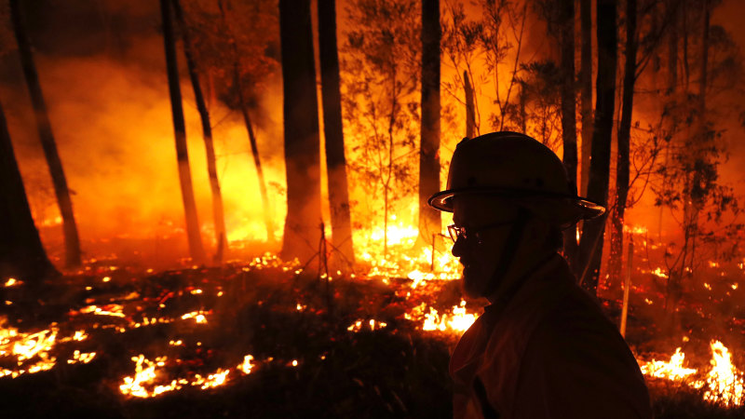
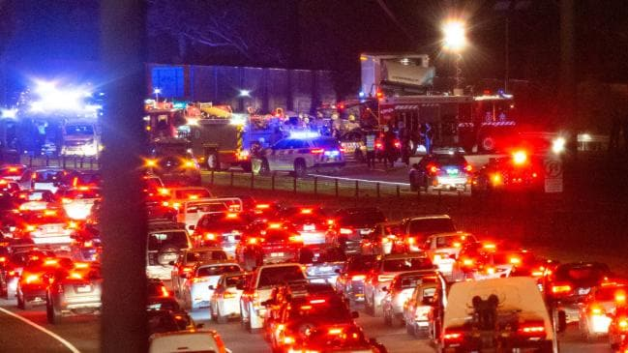

EMERGENCY MANAGEMENT
SIT-782 Team Project (A) – Project Management and Practices
Australian Bushfires Ambulance Data

Slide 2

Project Overview :
Ambulance data
Applying demographic characteristics to ambulance data and Road accident data
Bushfire data
To find out which areas raise the huge risk for bushfires across Australia and developing a website which gives out information for all regions which have frequent bushfires.

Slide 3

Deliverables of the Overall Project :
Task | Members | Technologies
Data Sourcing | Nithin, Mohan, Nikhil Reddy, Nikita, Bala, Varsha, Vijay | Various website
Data Cleaning | Nithin, Bala Tharun | Python
Prediction Analysis | Aiswarya ,Nithin, Mohan, Nikita, Piyush | Python
Data visualization | Pavan, Piyush, Nikhil, Simran, Shikhar | Tableau, GIS, Python
UI | Simran ,Nikita ,Varsha, Hamza, Pavan | Atom, HTML
Main deliverables:
Finding out areas which are highly prone to bushfires
Creating a website which gives out information on bushfires across Australia and provides precautions with details of the nearest fire brigade

Slide 4

Ambulance Victoria

Slide 5
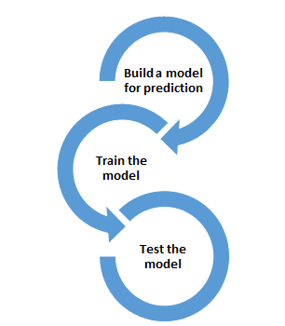


Visualization
Creating website
Data sourcing
Data cleaning
Methodology/Process

Slide 6
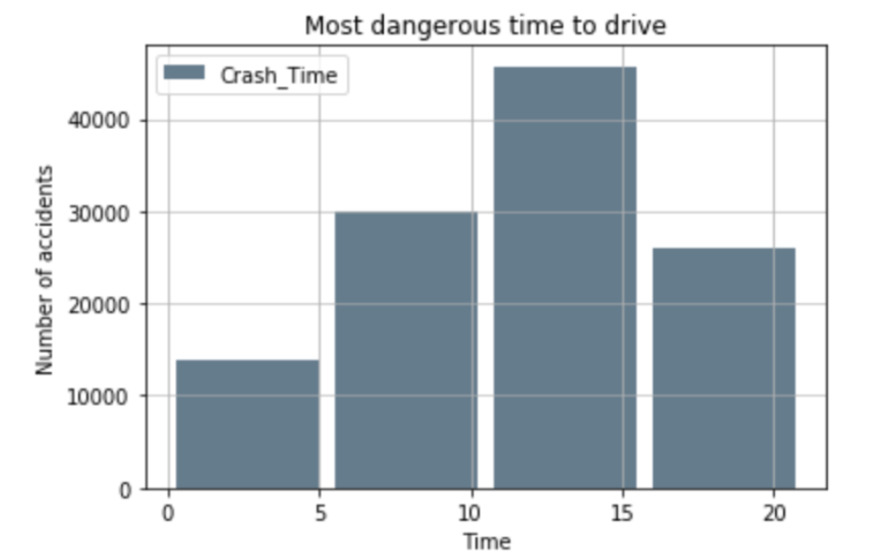
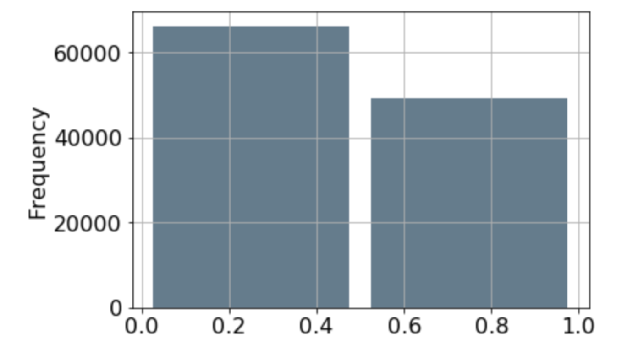
Based on Gender of Drivers
Prediction Based Of Demographic Characteristics

Slide 7
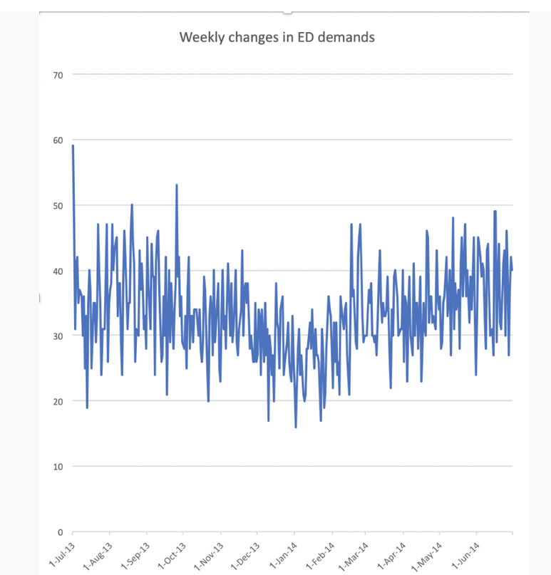
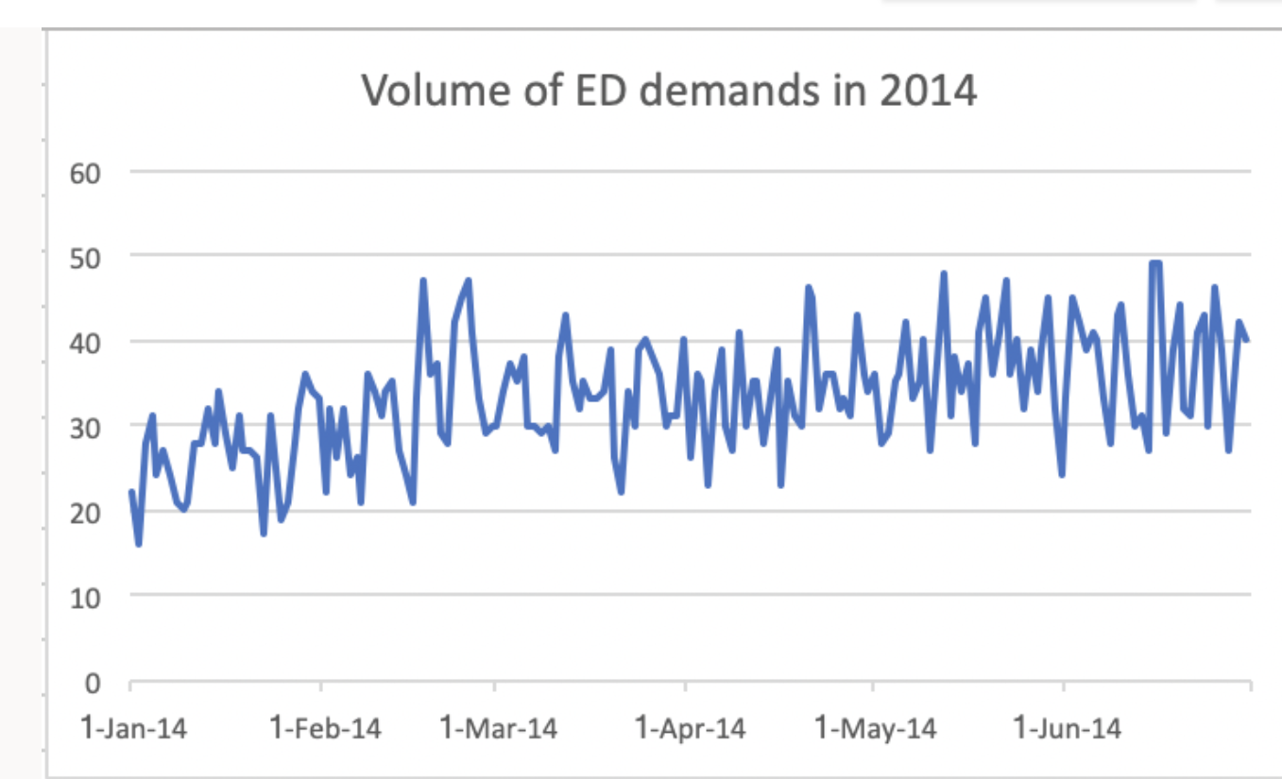
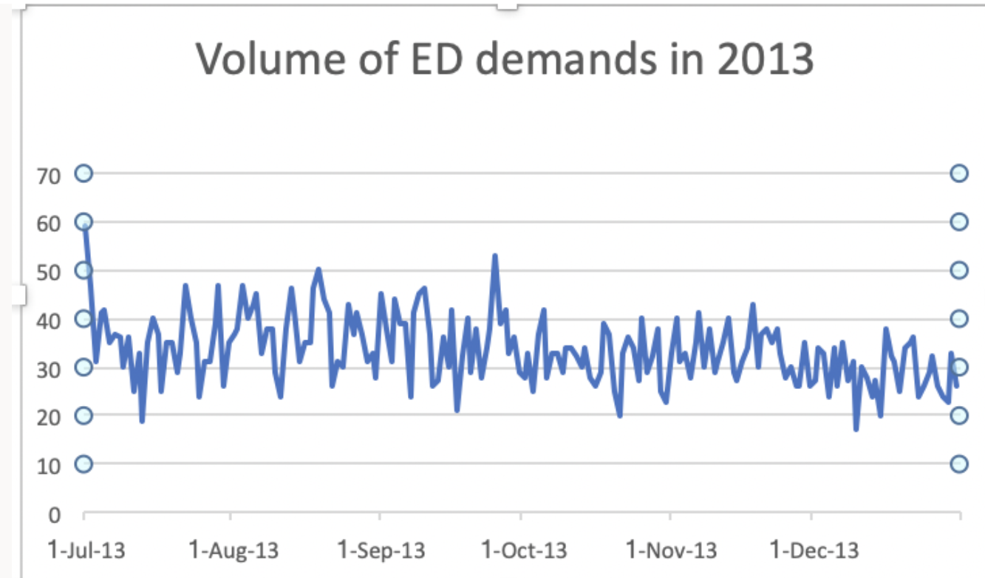

Slide 8
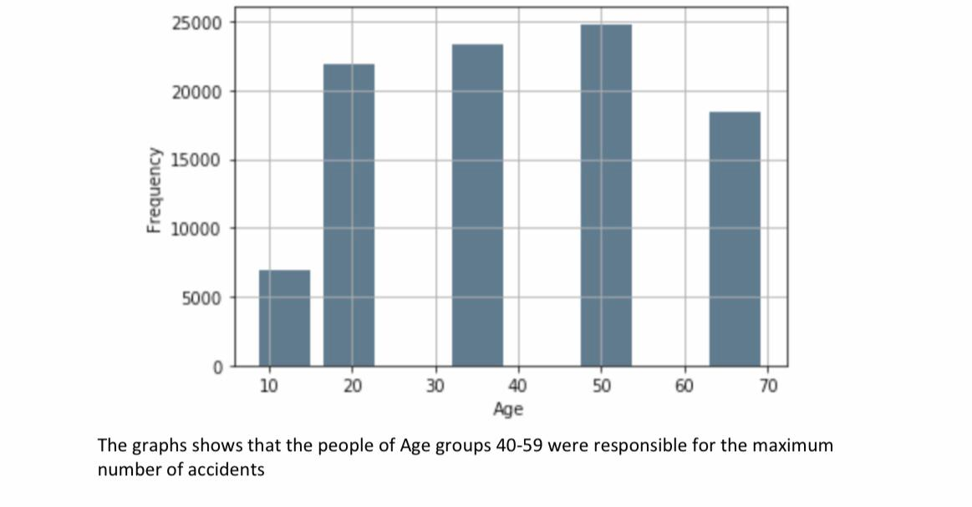

Slide 9
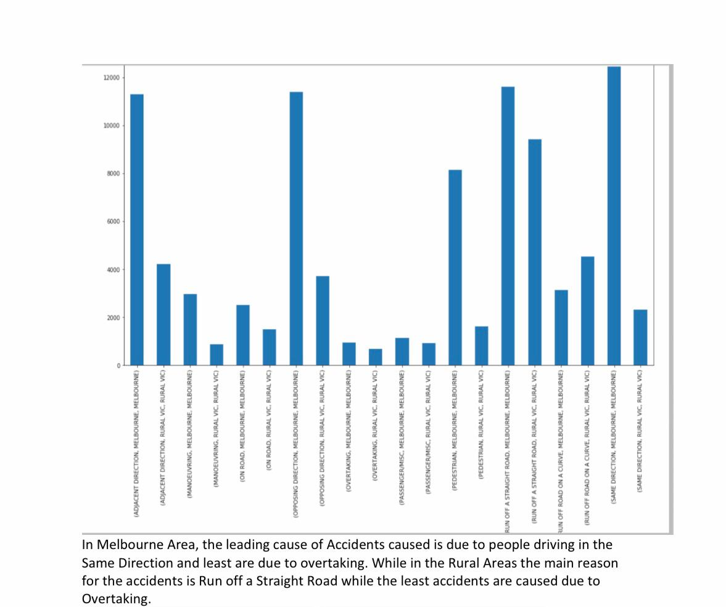

Slide 10
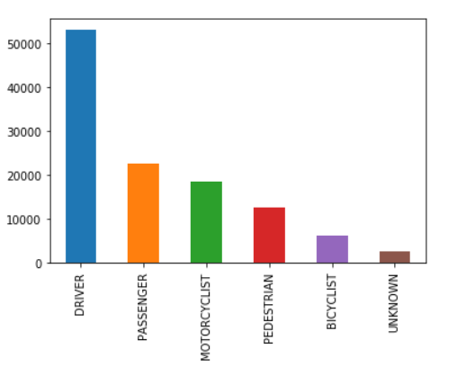
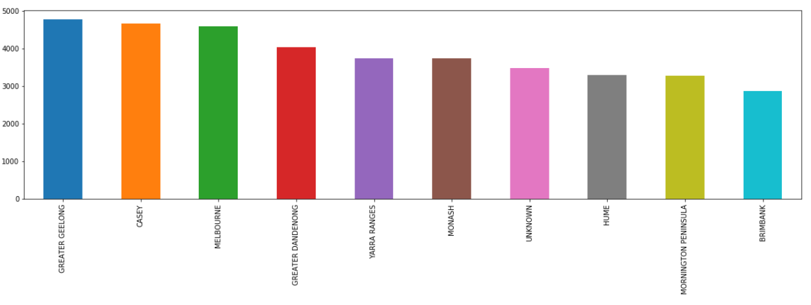
No. of accidents Vs Type of Vehicles
No. of accidents Vs Top 10 Crash Area

Slide 11
Bush Fire

Slide 12
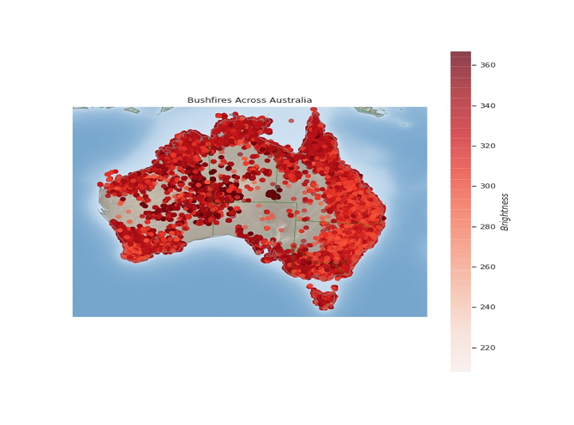
Deliverables of this iteration :
The main goal that we tried to achieve until now is to predict areas which are prone to bushfires by using different models and create a website which gives out information about bushfires
This graph shows the total number of bushfire cases across Australia. The fires have different levels of intensity which is demonstrated by the color map

Slide 13
PREDICTION ANALYSIS
We have chosen a dependent variable as a state for the first model, i.e. logistic regression which is used after encoding the categorical data, the accuracy of this model is 0.98
The prediction variable have features such as probability which can provide the likelihood of bushfires for different places with under various conditions
We used multinomial Logistic Regression which has an accuracy of 0.86

Slide 14
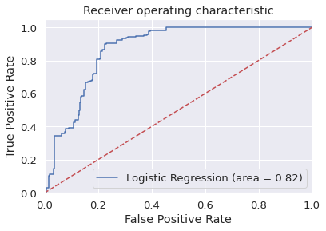
Predictions:
From the prediction analysis, suburbs such as Bairnsdale which had temperatures above 38-degree Celsius had the highest probability of bushfire with 0.879
The areas with temperatures lower than 12-degree Celsius and humidity greater than 30% had fewer chances of bushfires with probability of 0.39
Hence proved that weather conditions have an impact on bushfires

Slide 15
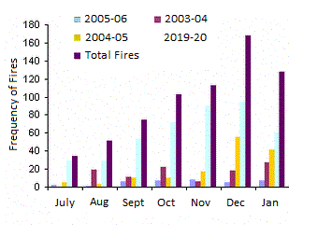
PREDICTION ANALYSIS:
A visualization of the frequency of bushfires data in the last two decades. The graph was plotted using Python.

Slide 16
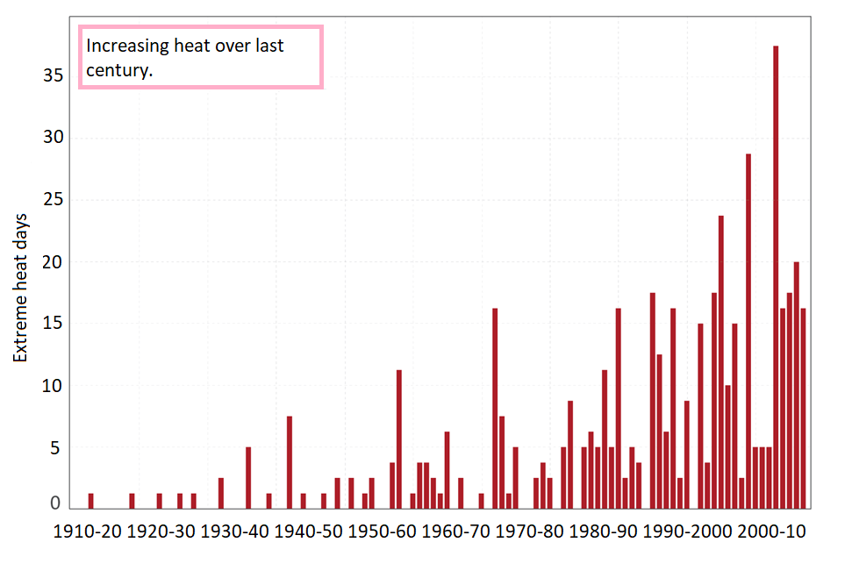
PREDICTION ANALYSIS:
This is the graphical representation of the increase in extreme heat days over the last century.

Slide 17
Website Creation
The team has created an access page for general public use and a made a main page with Victoria map
To create the website we are using Atom software where we run html code

Slide 18
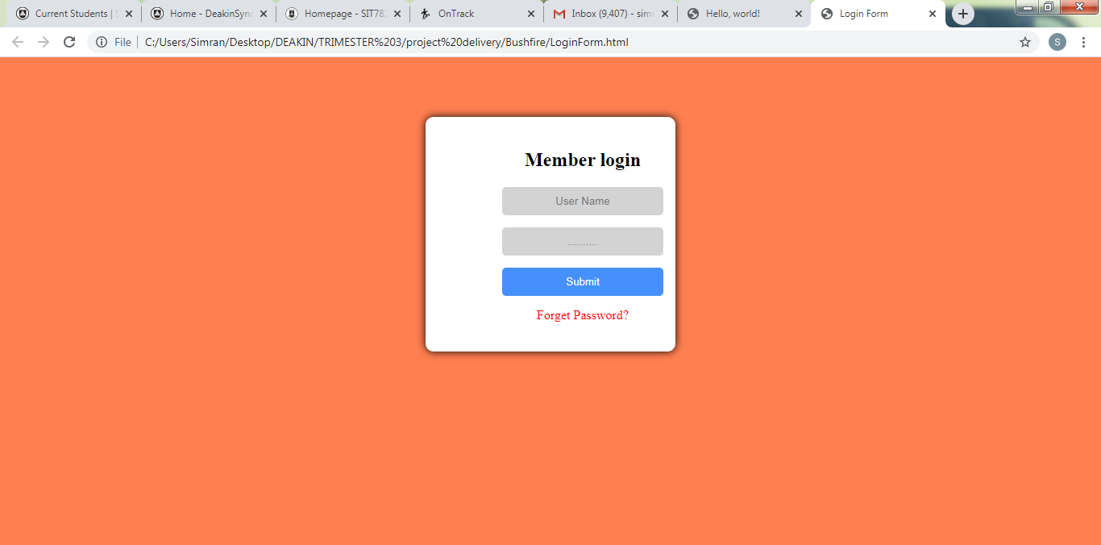

Slide 19
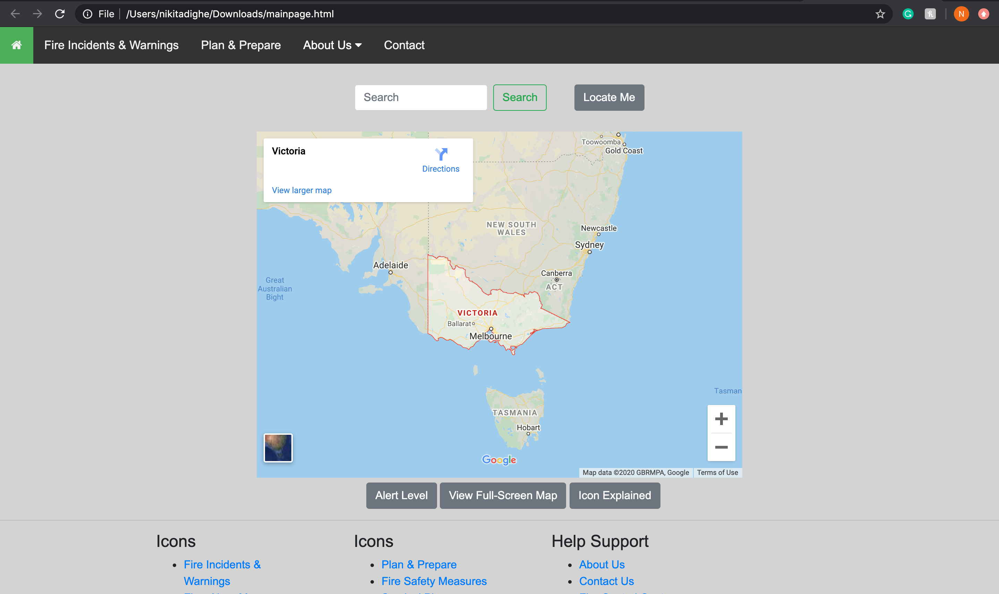

Slide 20
Challenges Faced :
Data Analysis : A new concept for some of the squad members.
User Interface : Figuring out the right software to build our web-app.
Prediction Analysis : Plotting and visualizing graphs and heatmaps to predict accurate data.

Slide 21
Team Contribution
Team Members​ | Major Contribution(s)​ ​ | Hours Recorded ​ ​
Mohan Kiran Bandaru​ | Visualization using Tableau and Python( time series for Canberra)​ Data sourcing for bushfire locations​ Documentation and it is showcased in folder "Mohan"​ | ​84
Hamza Zulfiqar​ | Data extraction for the bushfires, got familiar with python for my part in Iteration 2, learnt how to plot graphs and visualize data in python​ | ​70.5
Shikhar Dhyani​ | Data sourcing, documentation of presentations, upskilling in python, using python to create graphs for data analysis., prediction analysis of bushfire data | ​64.3
Piyush Gandhi​ | Data Sourcing, Analysis and Visualization of Ambulance Victoria Data, Predicting future Emergency Requirements.​ | ​95
Nithin Reddy Gundre​ | Data Sourcing, Extracting weather data, Visualization, Documentation of UI (prototype)​ | ​74
Nikhil Reddy Viraati​ | Data Sourcing, Data visualization, Working on the previous year's project Ambulance Data, Extracting Weather data relevant to the Bushfire Data.​ | ​80
Varsha Sankar​ | Data Sourcing, Data cleaning, Document presentation, Website creation of bushfire data. .​ | ​75

Slide 22
Team Member​ ​ | Major Contribution(s)​ | Hours Recorded ​ ​
Pavan Kumar Vadla​ ​ | Data Sourcing. ​Visualization of Ambulance Victoria Data. Predicting future Emergency Requirements and final documentation. Planning and Implementation of UI. | ​102
Nikita Shishupal Dighe​ ​ | Mentoring and Managing, Distribution of tasks, Data Sourcing, Analysis Visualization heatmaps, Preparing User Interface, Creation of database, Planning and execution of UI, Creating and Presenting the presentation​ | 103​
Aiswarya Subrahmanian​ ​ | Data sourcing for bushfire and weather data. Created heat maps for data. Mentoring. Did reverse geocoding for the bushfire data.​ Did bushfire prediction and analysis. | ​106
Vijay bathini​ ​ | Data souring, making presentations and Data Cleaning​ ​ | ​80
Bala Tharun Reddy Shymala​ ​ | Data Sourcing for Bushfire, Data Cleaning, extraction of weather data in respective with the bushfire locations​ ​ | ​83
Simran Rashpal Dhillon​ ​ | Planning of UI design, Wireframe representation, Implementation and Execution of UI​, Data Visualization with GIS ​ | ​88.5

Slide 23
Plan for the next iteration
To complete the website which is under construction and make it available to the public
An accurate map of Australia with areas which are prone to bushfires, highlighted
A website that gives out information about ongoing fires and provides with emergency hotline numbers
To handover the project to the next team progressing these ideas

Slide 24


THANK YOU

